Slide 1

Chapter 1:
Introduction to R Programming for Data Science

Slide 2
Getting Data into R 2

Slide 3
Objective
Create vectors in the R programming language,
Create factors in the R programming language,
Create a list in the R programming language,
Access and modify the list elements.

Slide 4

Vector
A vector is a one-dimensional array of objects, used for storing data.
Create vectors in R
Function | Example | Result
c(x,y) |  | 5 1 3 4
x:y |  | 3 4 5 6
seq(from, to, by, length.out) |  | 1 3 5 7 9
rep(x, times, each, length.out) |  | 3 3 5 5 3 3 5 5

Slide 5
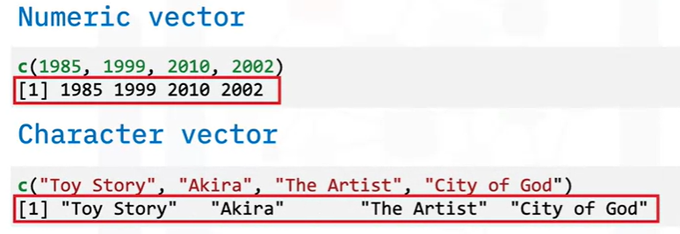
Vector
Create vectors in R: using c()

Slide 6
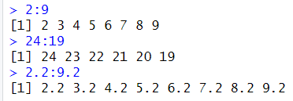
Vector
Create vectors in R: using a:b
a:b function takes two numeric scalars a and b as arguments, and returns a vector of numbers from the starting point a to the ending point b in steps of 1
Example

Slide 7
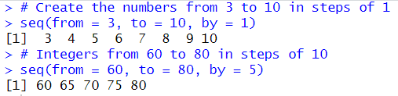
Vector
Create vectors in R: using seq()
seq(): create a sequence from a starting number to an ending number
Argument | Definition
from | The start of the sequence
to | The end of the sequence
by | The step-size of the sequence
length.out | The desired length of the final sequence (only use if you don’t specify by)

Slide 8
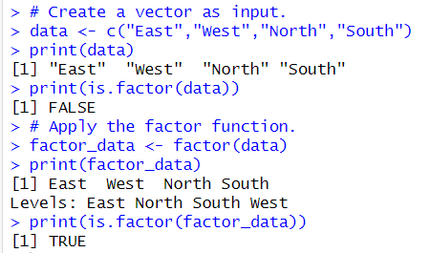
Factors
Factor in R is a variable used to categorize and store the data, having a limited number of different values. It can stores both string and integer data values as levels.
They are useful in data analysis for statistical modeling.
Syntax
factor(x = character(), levels, labels = levels, ordered = is.ordered(x))

Slide 9
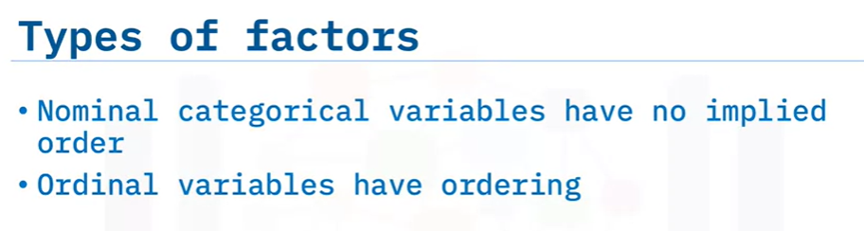
Factors

Slide 10
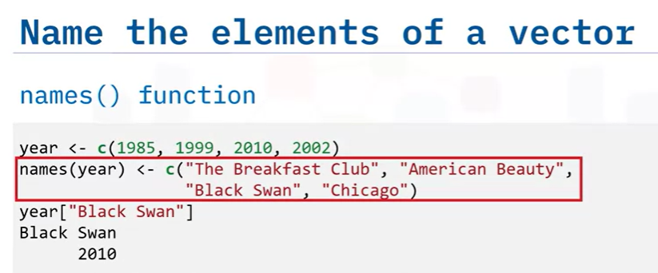
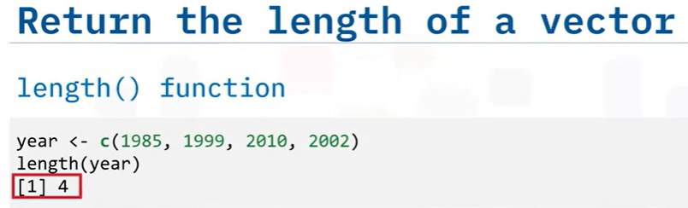
Vector Operations

Slide 11
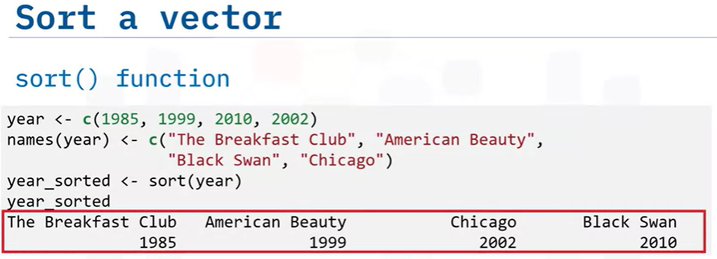
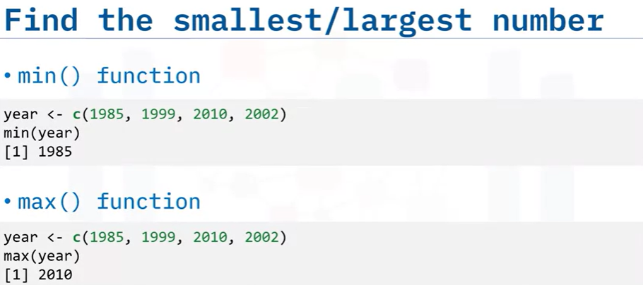
Vector Operations

Slide 12
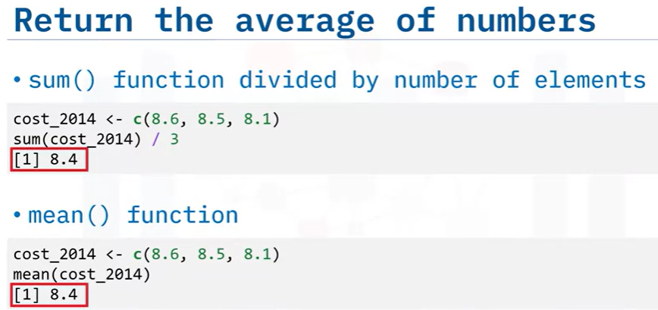
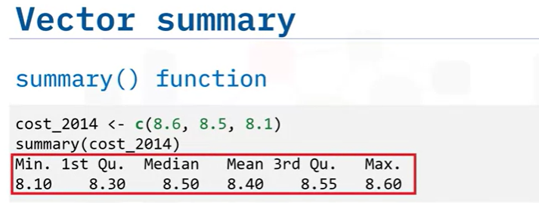
Vector Operations

Slide 13

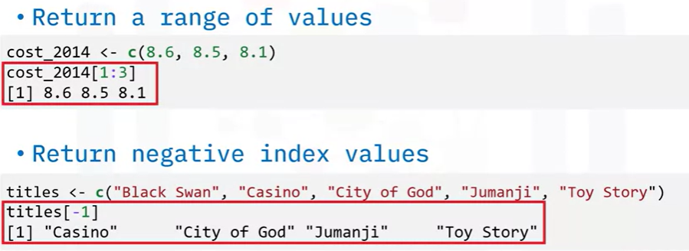
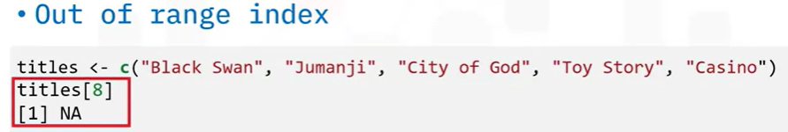
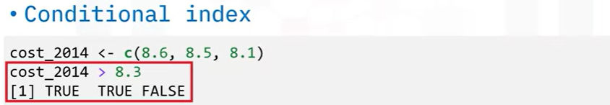
Vector Operations

Slide 14
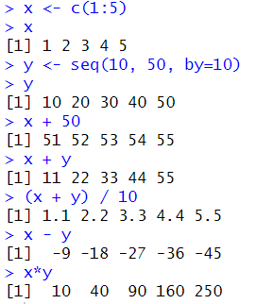
Arithmetic operations on vectors
Arithmetic operations on vectors
Basic arithmetic operations: +, -, *
Example

Slide 15

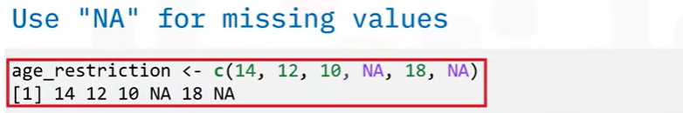
Vector Operations

Slide 16

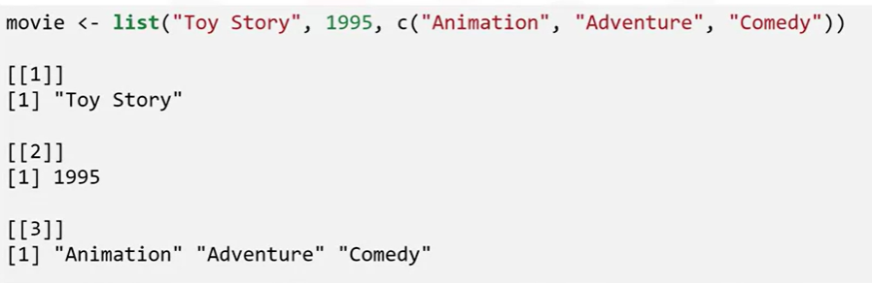
Lists
0:39/2:39
is a collection of objects in which the elements inside can differ in terms of data type

Slide 17
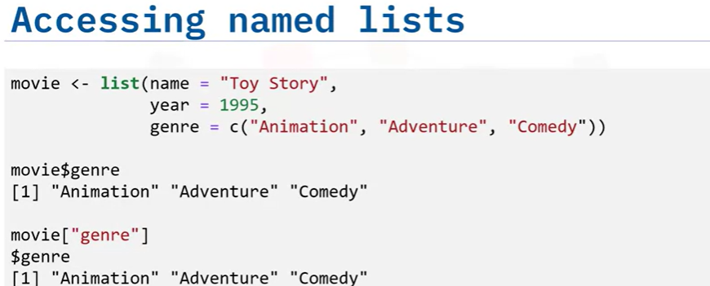
Lists
0:39/2:39

Slide 18

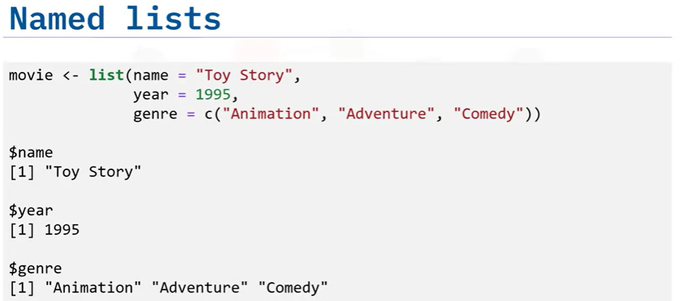
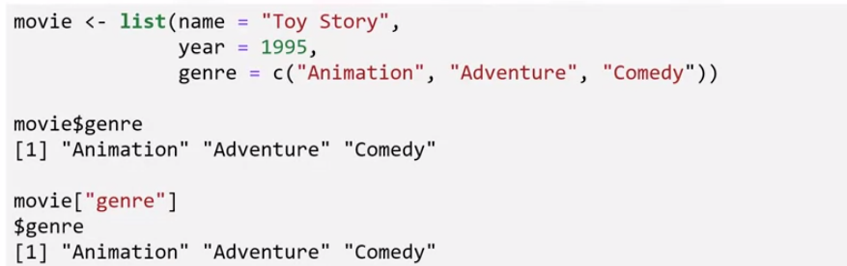
Lists
0:39/2:39

Slide 19
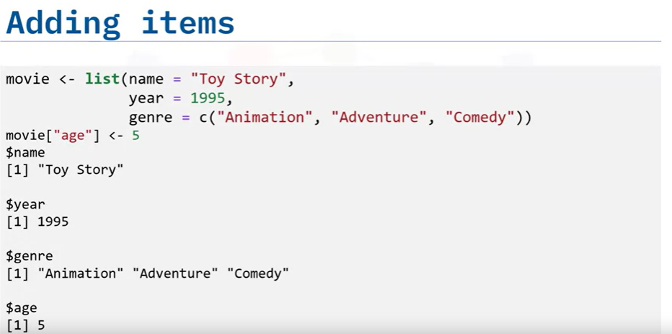
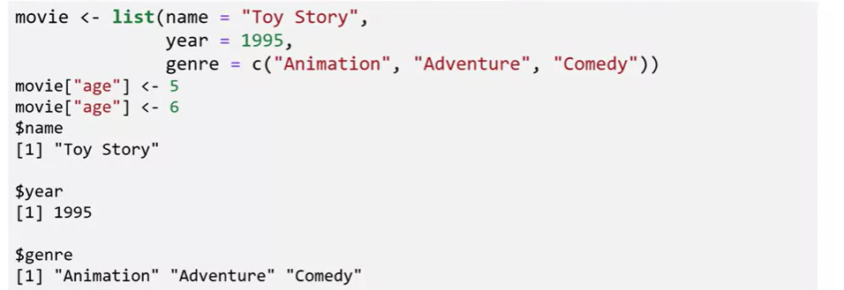
Lists
0:39/2:39
Chapter1- Importing Datasets

Slide 20

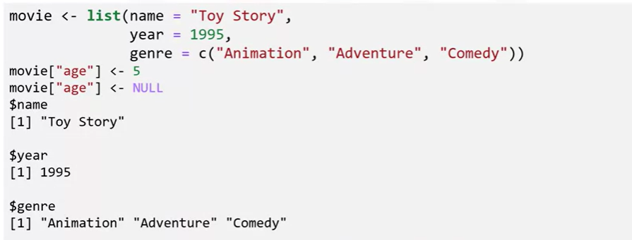
Lists
0:39/2:39

Slide 21
Summary
At this point in the course, you know:
A vector is a string of numbers, characters, or logical data.
Factors (also known as categorical variables) are variables that take on a limited number of different values that can be nominal or ordinal.
You can use R to perform operations on a vector, such as sorting the items, finding the smallest or largest number, or performing arithmetic on its values.
Lists can store different types of data, unlike vectors, which can only store data of a single type.

Slide 22
Q & A
Chapter1- Importing Datasets

